Slide 1

School of Basic and Applied Sciences
Course Code: BBS01T1002 Course Name: Semiconductor Physics
Quantum Free Electron Theory and Fermi Dirac Distribution function-II
Outlines:
Free Electron Gas in One-Dimensional Box (Potential Well Particle in box
Fermi Dirac Distribution function
Faculty Name: Dr Susmita Majumdar Program Name: B. Tech.

Slide 2

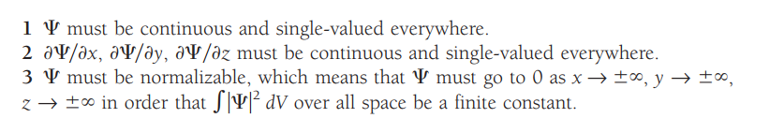
Prerequisite/Recapitulations
The quantity with which quantum mechanics is concerned is the wave function 𝞧 of a body. While itself has no physical interpretation, the square of its absolute magnitude |𝞧| ² evaluated at a particular place at a particular time is proportional to the probability of finding the body there at that time. The linear momentum, angular momentum, and energy of the body are other quantities that can be established from . The problem of quantum mechanics is to determine 𝞧 for a body when its freedom of motion is limited by the action of external forces.
since |𝞧| ² is proportional to the probability density P of finding the body described by , the integration of |𝞧| ² over all space must be finite—the body is somewhere, after all.
Normalization condition
Well-Behaved Wave Functions

Slide 3
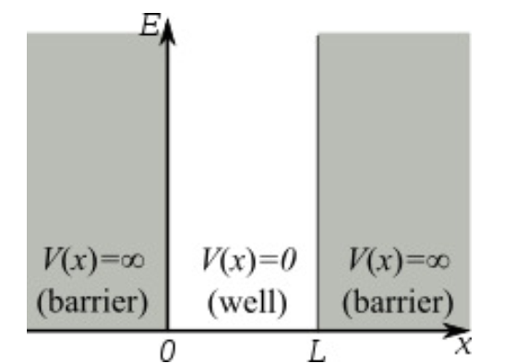
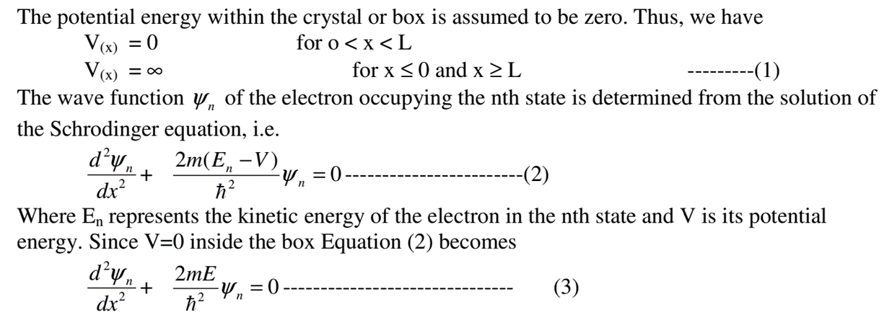
Free Electron Gas in One-Dimensional Box (Potential Well)
Consider an electron of mass ‘m’ which is bound to move in a one dimensional crystal of length ‘L’. The electron is prevented from leaving the crystal by the presence of a large potential energy barrier at its surfaces. Although the barriers extend over a few atomic layers near the surface, these are taken infinitely large for the sake of simplicity. The problem is identical to that of an electron moving in a one – dimensional potential box which is represented by a line and is bounded by infinite potential energy barriers as shown in figure

Slide 4
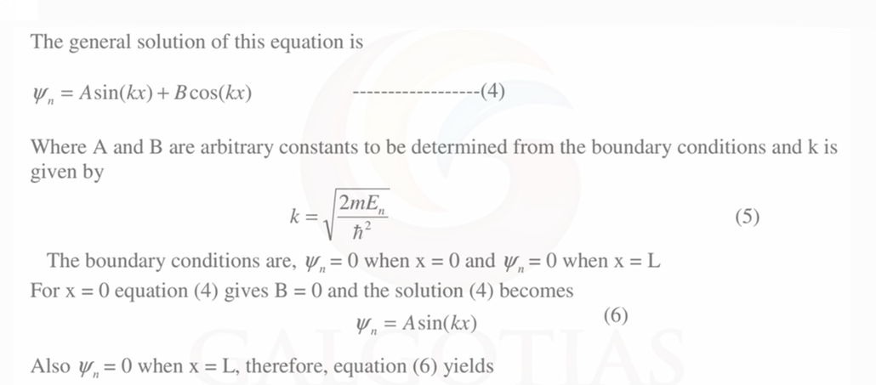

Free Electron Gas in One-Dimensional Box

Slide 5
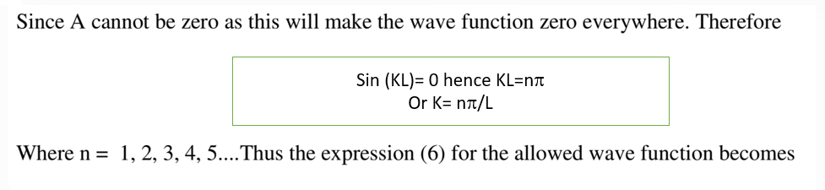
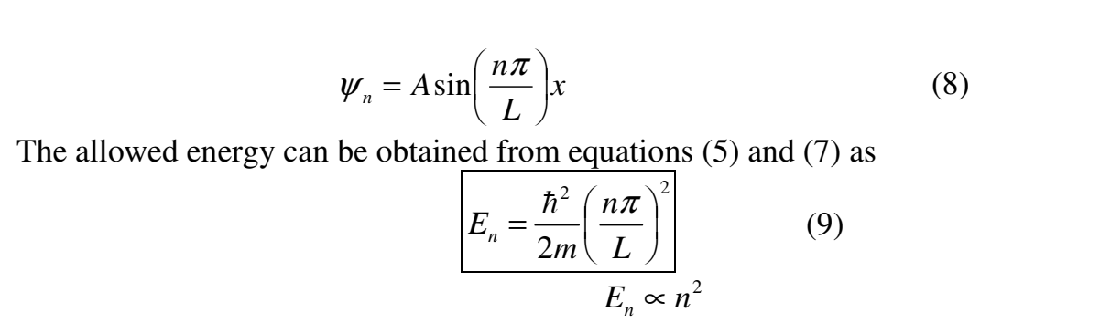
Free Electron Gas in One-Dimensional Box

Slide 6
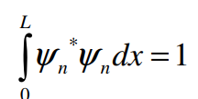
Free Electron Gas in One-Dimensional Box
For each value of n, there is an energy level and the corresponding wave function is given by equation (8). Each value of E_{n} is called an Eigen value and corresponding ψ _{n} is called Eigen function. Thus inside the box, the particle can only have the discrete energy values specified by equation (9). Note also that particle cannot have zero energy. The number n is called the quantum number. Hence energy spectrum consists of discrete energy levels where the spacing between the levels is determined by the values of n and L.
Expression for wave function:
It is certain that the particle is somewhere inside the box. The constant A in equation (8) is determined by using this information that the probability of finding an electron somewhere on the line is unity, i.e.

Slide 7
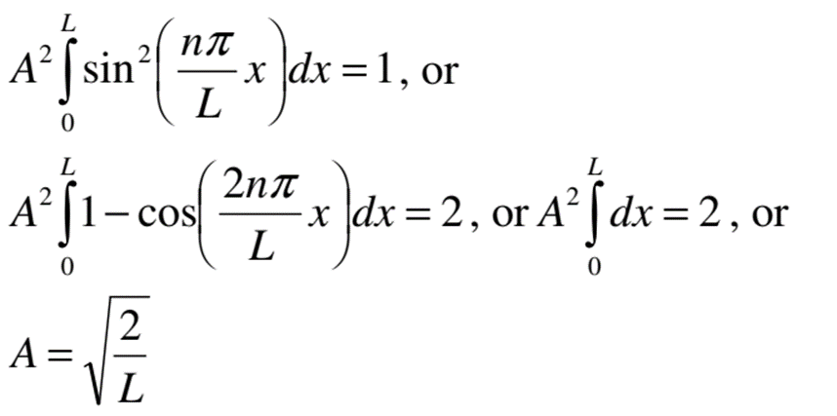
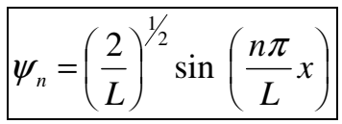
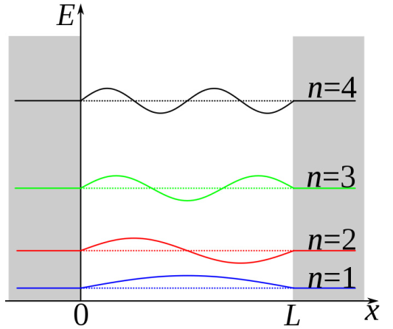
Expression for wave function
This is called as normalization condition. We get
So, we get the normalized wave function as
The energy levels and the wave functions corresponding to n=1, 2, 3, and 4 are shown

Slide 8
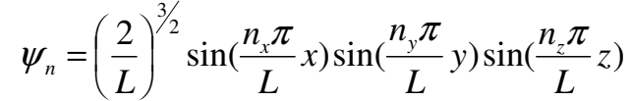
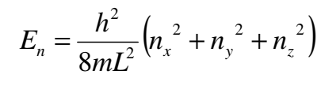
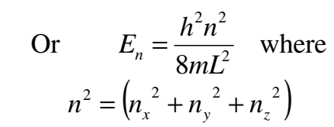
Free Electron Gas in Three Dimensions (Potential Well)
Let us consider a situation when the electrons are moving inside a three dimensional potential box of side ‘L’
the normalized wave function for cubical box becomes
The corresponding form of energy is given by
Thus in three dimensions, we have three quantum numbers nx, ny and nz which can take only positive integer values.
Thus each energy state is defined by a set of quantum numbers (nx, ny ,nz) and can contain a maximum of two electrons one spin up and other spin down in accordance to Pauli’s exclusion principle.

Slide 9
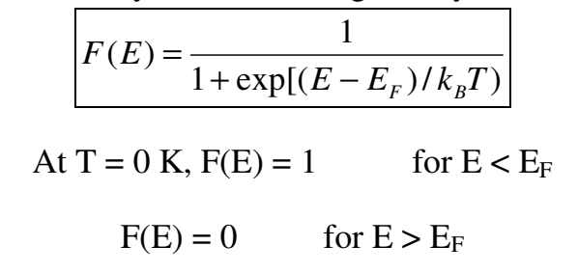
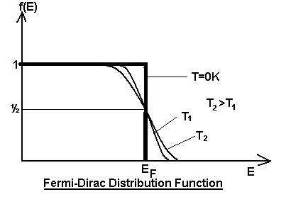
The Fermi-Dirac Distribution
The Fermi-Dirac distribution applies to fermions, particles with half-integer spin which must obey the Pauli Exclusion Principle. It gives the probability, F(E), for the occupation of a particular energy level E by an electron is given by
Where k_{B} is the Boltzmann's constant, T is the absolute temperature, E is the energy of the particular energy level E, and E_{F} is the Fermi energy
It can be seen that for T = 0, all the states up to energy EF are filled with electrons and all the states above EF are vacant. At E = EF the occupation probability is ½.
Thus the Fermi energy can be defined as the energy of the highest filled level at absolute zero. At a finite temperature, the electron may get the energy of order kBT and go to higher vacant state, and so

Slide 10
The Fermi-Dirac Distribution
the Fermi function falls. At any temperature T, when E = EF, F(E) = ½. This function is plotted for T = 0 K and for finite temperatures T1 and T2 with T1 < T2 in the Figure. The Fermi temperature TF and Fermi velocity vF are defined by following expressions: kBTF = EF i.e. TF = EF/ kB ½ mvF² = kBTF i.e. vF = (kBTF/m)^{1/2} For example, for sodium, EF = 3.2eV, This gives TF = 37100 K and vF = 1.1× 10⁶m/s

Slide 11
Applications of Fermi Energy
Fermi energy is used to separate the vacant and filled states at 0 K
It is used to know the status of the electrons.
Electrons are completely filled below fermi energy level and completely empty above the fermi level at 0 K
Above 0 K some electrons absorb thermal energy and they jumps to the higher energy levels.

Slide 12
Problem
Problem:The Fermi energy of sodium is 3.2eV, estimate the value of Fermi temperature
Solution:
E­_{f}= k T_{­f}
T_{­f} = 3.2/8.6x 10⁻⁵ = 37100 K

Slide 13
References
J. Singh , Semiconductor optoelectronics, Physics and Technology, Mc-Graw –Hill Inc.
S.O. Pillai , Solid State Physics, , New Age International (P) Ltd. Sixth edition, 2010.
S.M. Sze, Semiconductor Devices: Physics and Technology, Wiley 2008.
Introduction to Nanotechnology C P Poole, Frank J. Owens, John Wiley & Sons, 2011.
Introduction to Nanoscience and Nanotechnology, KK Chattopadhyay, A N Banerjee, Phi Learning Pvt Ltd., New Delhi, 2012.

